Slide 1
Memory-Efficient Regular Expression Search Using State Merging
IEEE INFOCOM 2007
Author: Michela Becchi
Presenter: Cheng-Feng Ke
Date: 2017/09/06
Department of Computer Science and Information Engineering
National Cheng Kung University, Taiwan R.O.C.
Notes:
1

Slide 2
INTRODUCTION
Regex
No
Construct a DFA
Maximum
Label
Weight Graphs for DFA
If there is any
weight > 0
Merge States
Finish
Yes
Output a DFA obtained after merging one or more state.

Slide 3
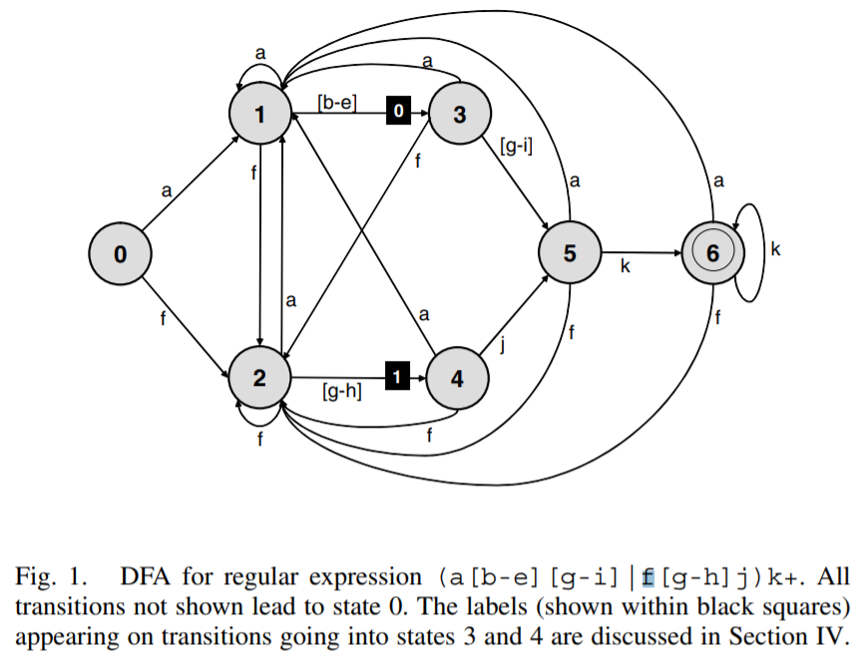
(a) Maximum Label
(b) Weight Graphs for DFA
(a[b-e][g-i]|f[g-h]j)k+

Slide 4
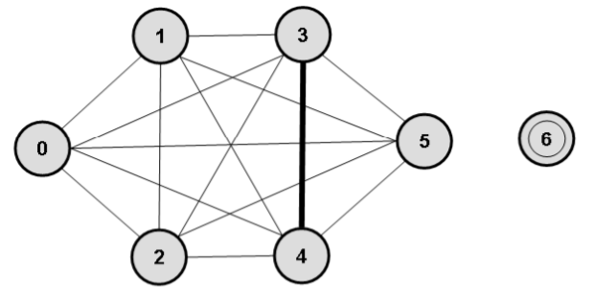
(a) Maximum Label
(b) Weight Graphs for DFA
Maximum Label = 2

Slide 5
(a) Maximum Label
(b) Weight Graphs for DFA
Maximum Label = 2

Slide 6
(a) Maximum Label
(b) Weight Graphs for DFA
Maximum Label = 2

Slide 7
(a) Maximum Label
(b) Weight Graphs for DFA
Maximum Label = 2

Slide 8
(a) Maximum Label
(b) Weight Graphs for DFA
Maximum Label = 2
1 + 1 = 2
2 <= Maximum Label
Number of Sub State = 1
Number of Sub State = 1

Slide 9
(a) Maximum Label
(b) Weight Graphs for DFA
Maximum Label = 2
Weight = 0

Slide 10
(a) Maximum Label
(b) Weight Graphs for DFA
Maximum Label = 2
Number of Sub State = 1
Number of Sub State = 1

Slide 11
(a) Maximum Label
(b) Weight Graphs for DFA
Maximum Label = 2
Weight = 1

Slide 12
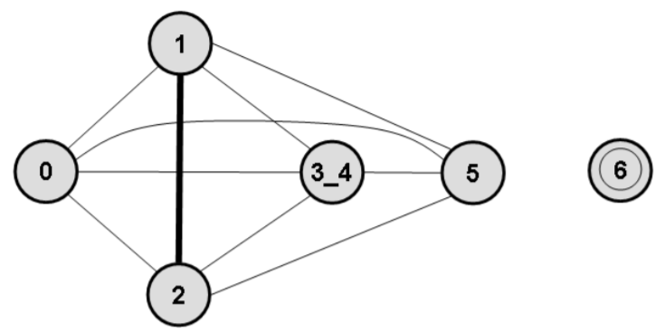
(a) Maximum Label
(b) Weight Graphs for DFA
Maximum Label = 2
1 + 2 = 3
3 > Maximum Label
Number of Sub State = 1
Number of Sub State = 2

Slide 13
(a) Maximum Label
(b) Weight Graphs for DFA
Maximum Label = 2
Weight = 1

Slide 14
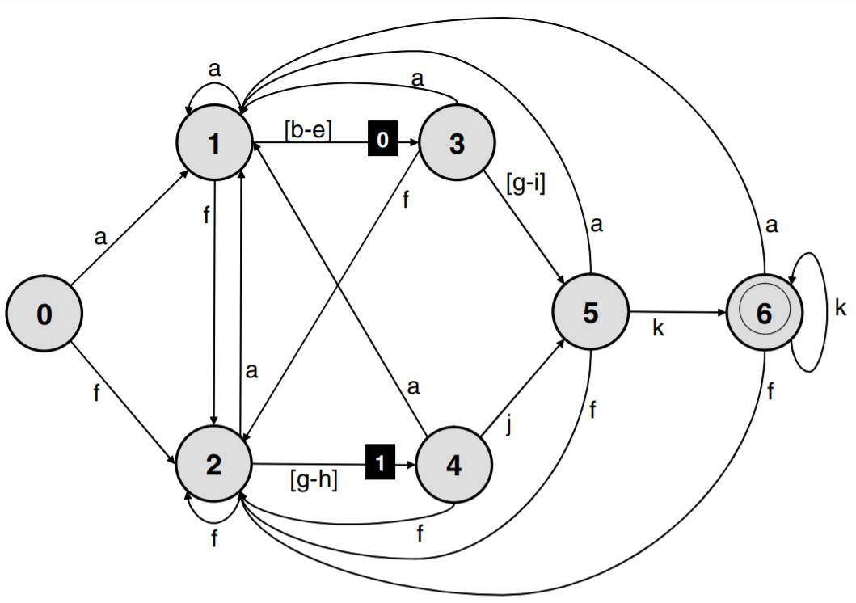
(c) Merge States
Maximum Label = 2

Slide 15
(c) Merge States
Maximum Label = 2
State 3 Bitmap (256 bits)
other | a | b | c | d | e | f | g | h | i | other
0 | 1 | 0 | 0 | 0 | 0 | 1 | 1 | 1 | 1 | 0
3
Index | Transition index
0 | 0
1 | 1
2 | 2
3 | 2
4 | 2
Transition Table
Index | Next State
0 | 1
1 | 2
2 | 5

Slide 16
(c) Merge States
Maximum Label = 2

Slide 17
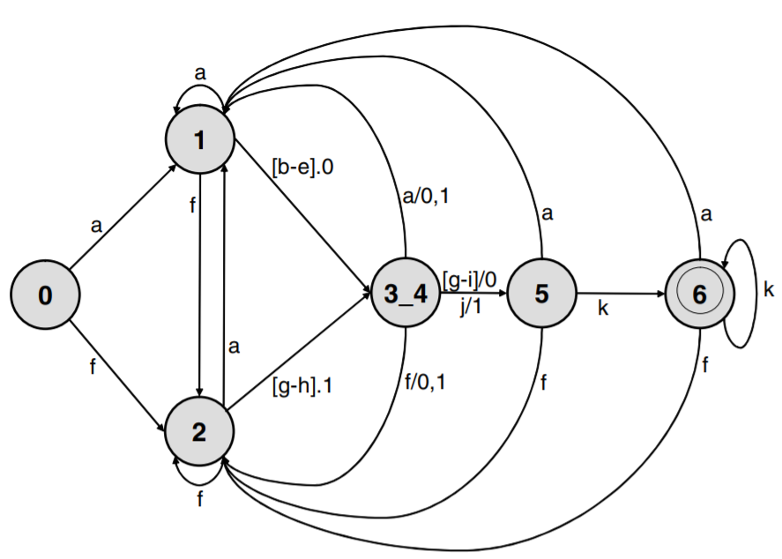
(c) Merge States
Maximum Label = 2
Symbol . Destination State / Source States

Slide 18
(c) Merge States
Maximum Label = 2
Label 0 = > State 3
Label 1 => State 4
Input “g”
Input “b”
Label = 0

Slide 19
(c) Merge States
Maximum Label = 2
State 3 Bitmap (256 bits)
other | a | b | c | d | e | f | g | h | i | other
0 | 1 | 0 | 0 | 0 | 0 | 1 | 1 | 1 | 1 | 0
State 4 Bitmap (256 bits)
other | a | b | c | d | e | f | other | i | j | other
0 | 1 | 0 | 0 | 0 | 0 | 1 | 0 | 0 | 1 | 0
State 3 Index | Transition (Label)
0 | 0 (Null)
1 | 1 (Null)
2 | 2 (Null)
3 | 2 (Null)
4 | 2 (Null)
State 4 Index | Transition (Label)
0 | 0 (Null)
1 | 1 (Null)
2 | 2 (Null)
Common Transition Table
Index | Next State
0 | 1
1 | 2
2 | 5

Slide 20
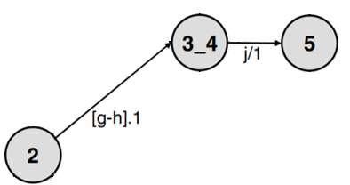
(c) Merge States
Maximum Label = 2
State 3 Bitmap (256 bits)
other | a | b | c | d | e | f | g | h | i | other
0 | 1 | 0 | 0 | 0 | 0 | 1 | 1 | 1 | 1 | 0
State 4 Bitmap (256 bits)
other | a | b | c | d | e | f | other | i | j | other
0 | 1 | 0 | 0 | 0 | 0 | 1 | 0 | 0 | 1 | 0
State 3 Index | Transition (Label)
0 | 0 (Null)
1 | 1 (Null)
2 | 2 (Null)
3 | 2 (Null)
4 | 2 (Null)
State 4 Index | Transition (Label)
0 | 0 (Null)
1 | 1 (Null)
2 | 2 (Null)
Common Transition Table
Index | Next State
0 | 1
1 | 2
2 | 5

Slide 21
(c) Merge States
Maximum Label = 2

Slide 22
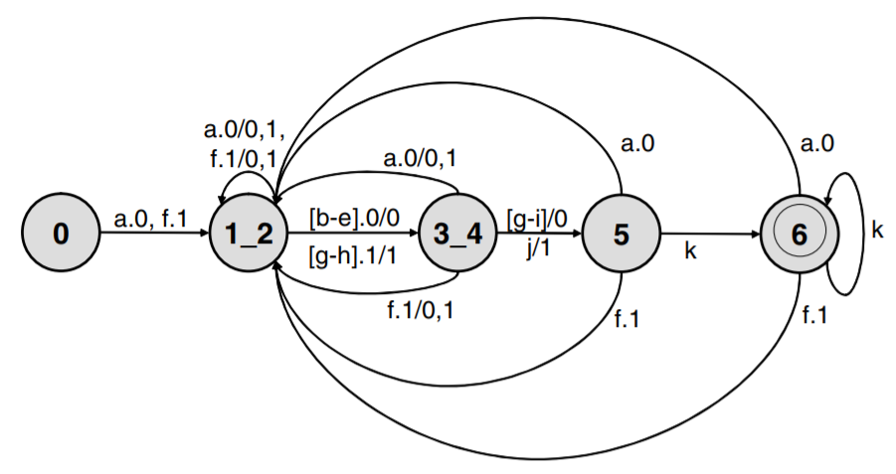
(c) Merge States
Maximum Label = 2

Slide 23
(c) Merge States
Maximum Label = 2
State 1 Bitmap (256 bits)
other | a | b | c | d | e | f | g | h | i | other
0 | 1 | 1 | 1 | 1 | 1 | 1 | 0 | 0 | 0 | 0
State 2 Bitmap (256 bits)
other | a | b | c | d | e | f | g | h | i | other
0 | 1 | 0 | 0 | 0 | 0 | 1 | 1 | 1 | 0 | 0
State 1 Index | Transition (Label)
0 | 0 (0)
1 | 1 (0)
2 | 1 (0)
3 | 1 (0)
4 | 0 (1)
State 2 Index | Transition (Label)
0 | 0 (0)
1 | 1 (1)
2 | 1 (1)
3 | 1 (1)
Common Transition Table
Index | Next State
0 | 1_2
1 | 3_4

Slide 24
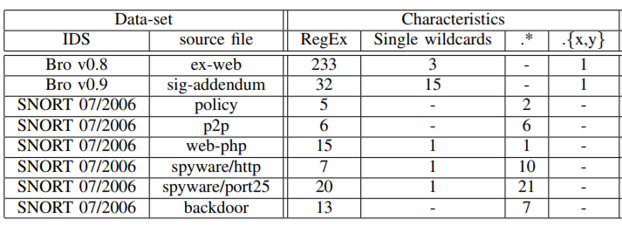
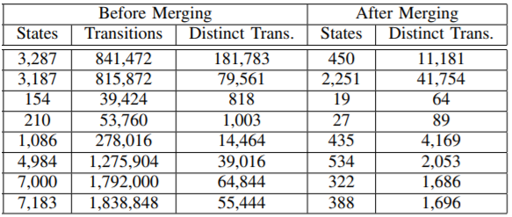
EXPERIMENTAL RESULTS

Slide 25
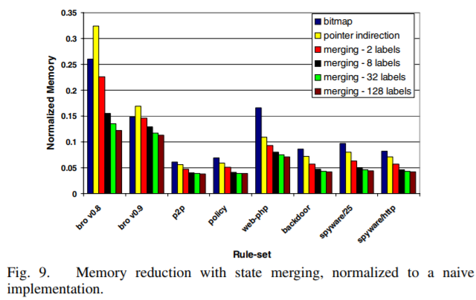
EXPERIMENTAL RESULTS

